Slide 1
A Level History

Slide 2
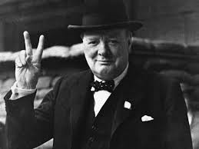
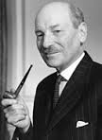
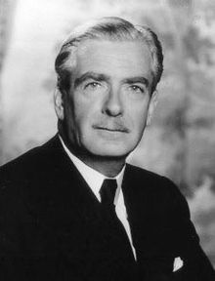
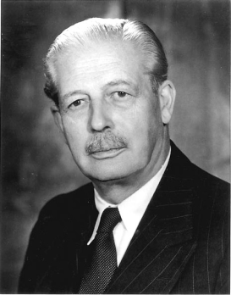
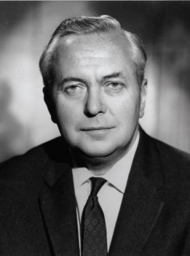
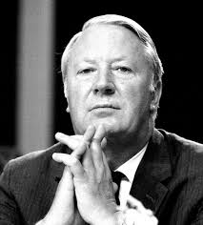
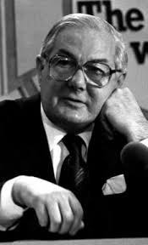
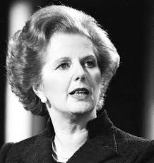
Unit 1: British period study and enquiry
25% of A Level
Paper is 1hr 30mins. Worth 50 marks.
Year 12
Britain 1930 – 1997
Enquiry Topic: Churchill 1930-51

Slide 3
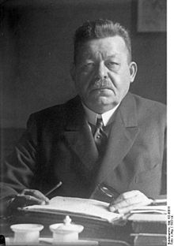
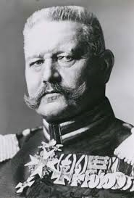
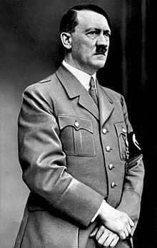
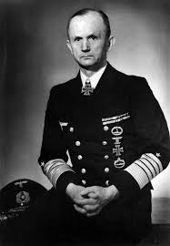
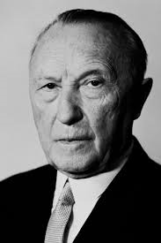
Unit 2: Non-British period study
15% of A Level
Paper is 1hr (30 marks)
Year 12
Democracy and dictatorships in Germany 1919 - 1963

Slide 4
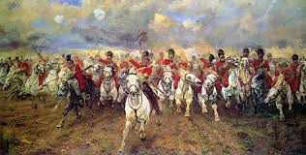
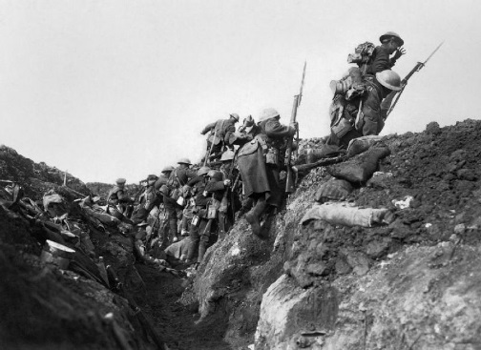
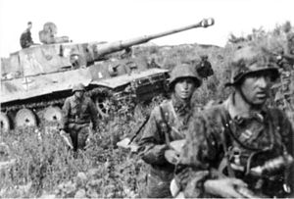
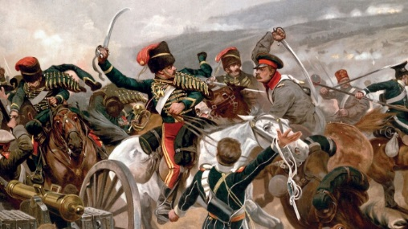
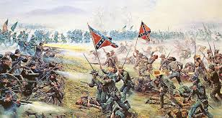
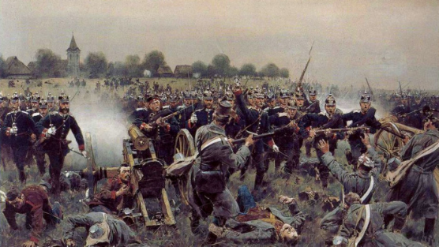
Unit 3: Thematic study and historical interpretations
40% of A Level
Paper is 2hr 30mins. Worth 80 marks.
Year 13
The Changing Nature of Warfare
1792 - 1945

Slide 5
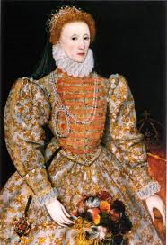
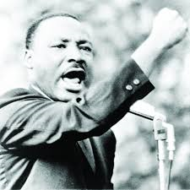
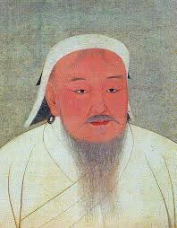
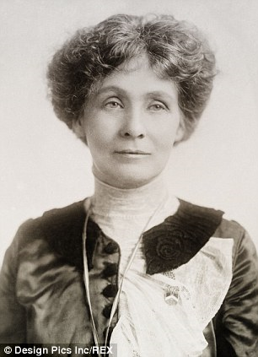
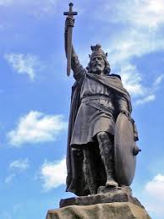
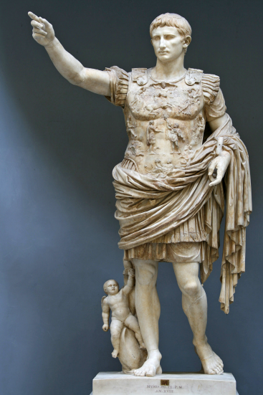
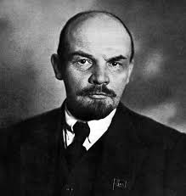
Unit 4: Topic based essay
20% of A Level
3000-4000 word coursework essay (No exam)
Year 13
A topic of your choice

Slide 6
Unit 1: Enquiry Topic – Churchill 1930-51
The Enquiry is a source based study. The examination questions related to Churchill are all based on analysis of sources.
Churchill 1930-51
Why Churchill was out of office between 1929-39
Why Churchill became Prime Minister in 1940
Churchill’s relations with his generals
Churchill’s military strategy
Why Churchill lost the 1945 election
Churchill and international diplomacy 1939 – 51
Relations with Roosevelt, Stalin and De Gaulle
International conferences
Iron curtain speech
Attitude to Britain and Empire after 1945

Slide 7
Unit 1: Britain 1951 - 1997
This section of Unit 1 is examined with essay questions. You choose your favourite from the 2 choices.
Britain 1951 – 1997
Conservative domination 1951 – 1964
Social change and prosperity
Conservative leadership, scandals and decline
Labour and Conservative governments 1964-79
Economic problems and solutions
Trade Unions
Thatcher and the end of consensus
Social, economic, political and European issues
Fall of Thatcher
Rise of ‘New Labour’
Britain’s position in the world 1951 - 1997

Slide 8
Unit 2: Democracy and dictatorship in Germany 1919 - 1963
The establishment and development of the Weimar Republic: 1919 – Jan 1933
The establishment of the Nazi dictatorship and its domestic policies Feb 1933 – 1939
The impact of war and defeat on Germany 1939 – 1939
Divided Germany: The Federal Republic and the DDR 1949 – 1963

Slide 9
Unit 3: The Changing Nature of Warfare 1792 - 1945
This unit examines the changing nature and methods of land warfare. Pupils need to be able to follow developments and themes across the chronological period to reach judgements.
Key topics:
The impact of factors directly related to the conduct of war
The impact of technological change
Planning and preparation for war
The relationship between relevant domestic factors and war
Depth Studies
French Revolutionary Wars 1792 – 1802
The American Civil War 1861 – 1865
The First World War 1914 – 1918

Slide 10
Unit 4: Coursework
You develop the question and then the answer.
Any topic or period
Must be a debate question
You must be able to access and utilise Sources and Interpretations related to the topic

Slide 11
Why study History?
Interesting courses chosen by staff members to reflect their personal areas of interest and expertise
100% of History students who applied to University were admitted onto a course of their choice
Average class size is 10 students
Experienced staff with degree qualifications in History
One to one support offered
Sessions related to examination success available
Additional lessons offered
Lunchtime viewing of relevant documentaries

Slide 12
Stationery Requirements
Two Lever Arch History folders
Dividers
Germany = 6 required
Britain = 6 required
File paper
Highlighters and Post-it notes

Slide 13
Bridging Work
In order to maximise your chances of success at A Level, the following will help you on your way.
British History 1929 – 1997
Andrew Marr’s ‘History of Modern Britain’: This is available as a TV series and as a book. Copies of the book can be requested from me.
Focus on the period from 1929 – 1945
German History 1918 – 1963
Revise your GCSE notes on Weimar Germany 1918 – 1933.

Slide 14
15 Minute Taster Session
General Elections Poem – 1951 to 1997
Thatcher Poem

